Slide 1
Automated Test Execution & Reporting Framework

Slide 2
Automated Test Execution & Reporting Framework
agenda
AGENDA
Project Overview
Dataset
Tech Stack & Python Concepts Used
Output Reports & Dashboard
Summary & Future Scope

Slide 3
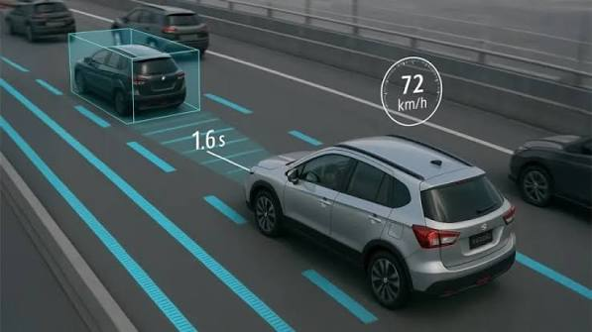
Automated Test Execution & Reporting Framework
Project Overview
Adaptive Cruise Control (ACC) is an Advanced Driver Assistance System (ADAS) feature that automatically maintains the vehicle's speed while ensuring a safe distance from the vehicle ahead. Manual validation of ACC test cases can be time-consuming, repetitive, and prone to human errors.
The objective of this project is to develop a Python-based automation framework that validates ACC functionality by executing predefined test cases from Excel files, evaluating system behavior against expected rules, and generating professional reports automatically.

Slide 4
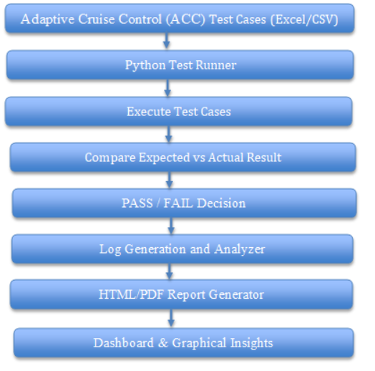
Automated Test Execution & Reporting Framework
Project Objectives
ACC test case validation.
Reduce manual testing effort and execution time.
Detect missing and invalid test data.
Simulate ACC decision-making based on defined rules.
Generate Pass/Fail analysis and graphical insights.
Produce HTML, Word, and PDF reports automatically.

Slide 5
Automated Test Execution & Reporting Framework
Dataset
Ignition – Vehicle power status (ON/OFF).
Vehicle Speed – Current speed of the vehicle.
Set Speed – Driver-selected speed for ACC.
Lead Vehicle Detected – Indicates whether a vehicle is ahead.
Lead Vehicle Speed – Speed of the vehicle ahead.
Following Distance – Distance to the vehicle ahead.
Test Case Action – ACC operation being tested (ACC ON, Resume, Maintain, etc.).
Expected Result – Expected ACC behavior for validation.
Dataset

Slide 6
Automated Test Execution & Reporting Framework
Tech Stack & Python Concepts Used
Tech Stack
1
2
Python Libraries
Python Concepts Used
3
Python 3.x – Core programming language
VS Code – Development environment
Excel / CSV – Test case data management
HTML, Word, PDF – Report generation formats
Python Libraries Pandas – Data processing and Excel handling
OpenPyXL – Excel file operations
Matplotlib – Pie chart generation python-docx – Word report creation
Pathlib – File and folder management
Logging – Execution log management
Object-Oriented Programming (OOP) Classes & Objects
Static Methods
Dictionaries & Lists
Conditional Statements
Functions & Modules
Exception Handling
File Handling Data
Validation Logic

Slide 7
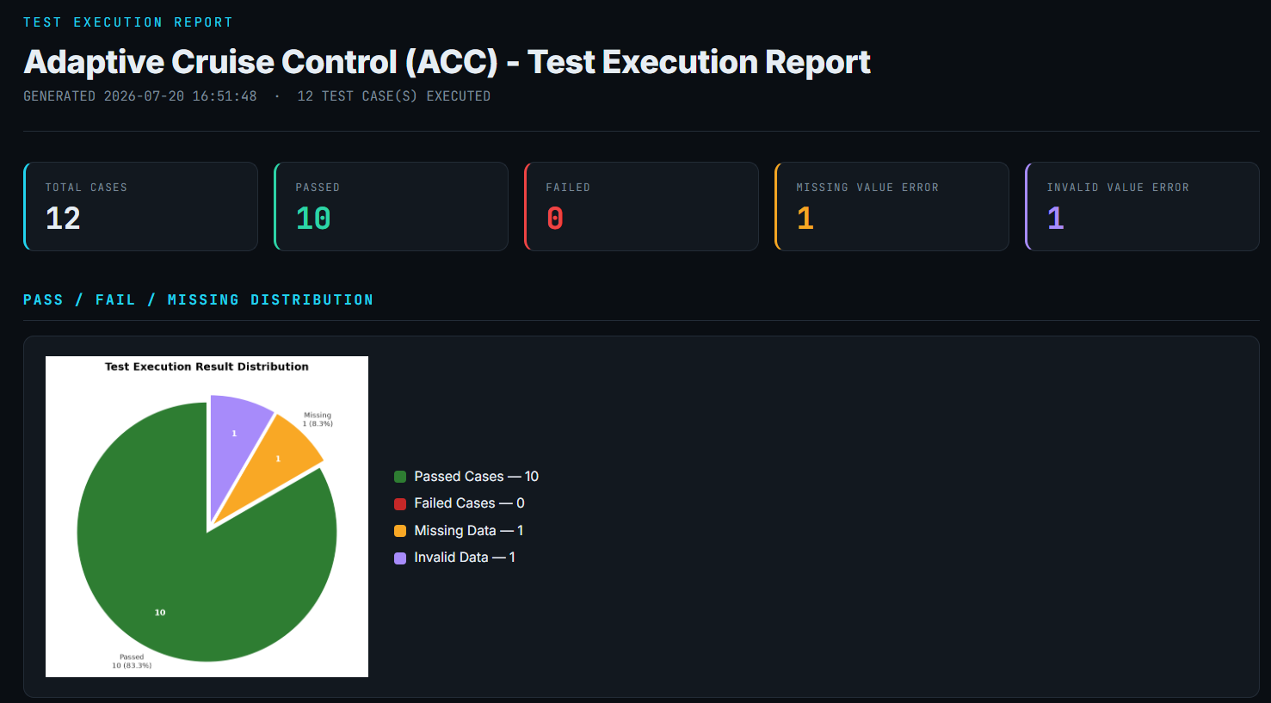
Automated Test Execution & Reporting Framework
Output Reports & Dashboard

Slide 8
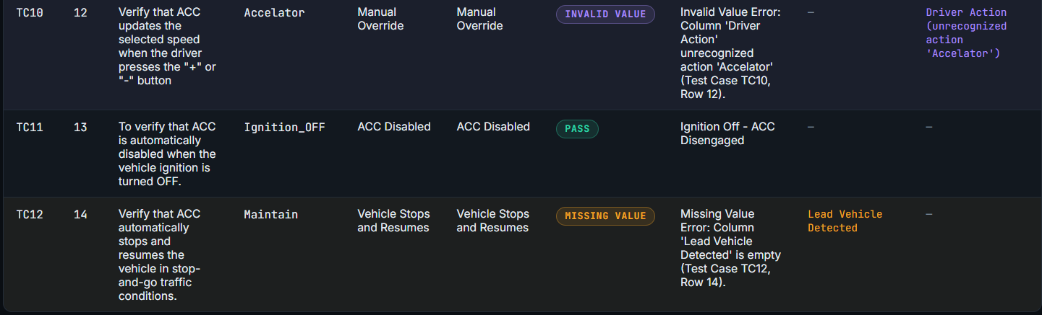
Automated Test Execution & Reporting Framework
Output Reports & Dashboard

Slide 9
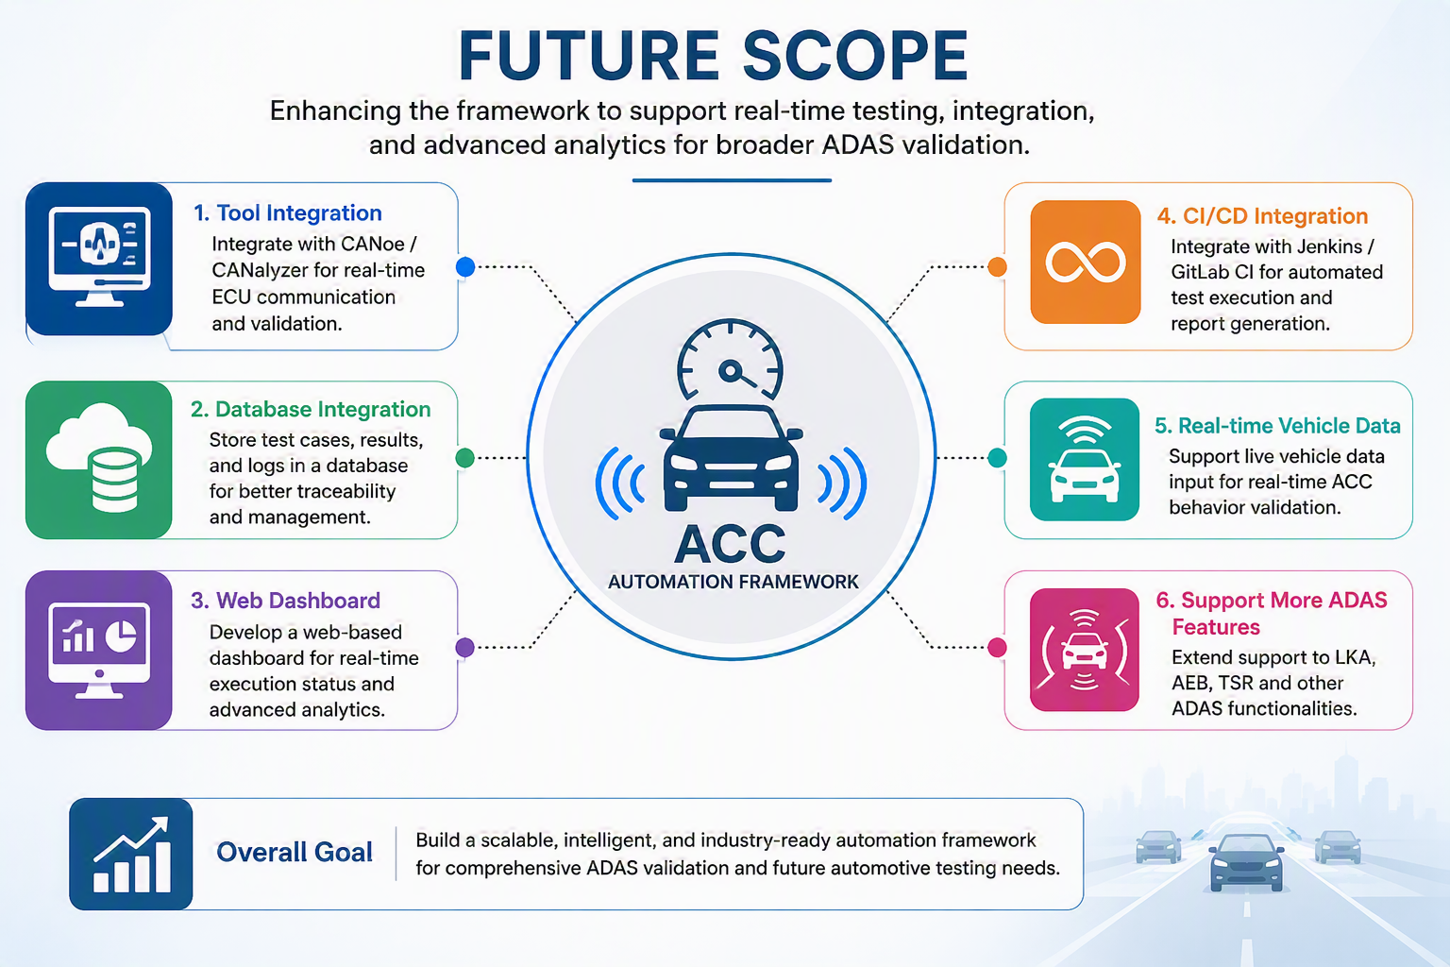
Automated Test Execution & Reporting Framework
Summary & Future Scope
Summary
Automates ACC test case validation.
Generates reports and Pass/Fail dashboards.
Reduces manual effort and improves accuracy.
Future Scope
Integrate with CANoe/CANalyzer.
Add real-time vehicle data testing.
Support more ADAS features such as AEB and LKA.
Automated ACC testing framework that validates test cases and generates reports, with potential for future integration into real automotive testing environments.

Slide 10
THANK YOU
Automated Test Execution & Reporting Framework
MEGA PROJECT
Vijayalakshmi - EDAG Git Link
Sai varshith - Edag git link
Apurv tripathi - edag git link

